Slide 1


Felipe Seleme Ribeiro
Jun/2023

Slide 2

Outline
Executive Summary
Introduction
Methodology
Results
Conclusion

Slide 3
Executive Summary
Summary of methodologies
Data Collection through Application Programming Interface - API
Web Scraping Data Collection
Data Wrangling
Exploratory Data Analysis with Structured Query Language – SQL EDA
Exploratory Data Analysis with Data Visualization – DataViz EDA
Interactive Dashboard Analysis with Folium
Machine Learning Predictions
Summary of all results
Exploratory Data Analysis with Charts and Tables
Predictive Models Results for SpaceX Falcon 9 First Stage Landing Success

Slide 4
Introduction
Project background and context
In the project's introduction, we highlight the background and context of the study, focusing on SpaceX and its Falcon 9 rocket launches. SpaceX stands out by offering significantly lower prices, with a launch cost of $62 million compared to competitors' prices exceeding $165 million. This cost reduction stems from SpaceX's ability to recover and reuse the Falcon 9's first stage. If we can accurately predict the success of the first stage landing, it becomes possible to determine the cost associated with each launch. This valuable information can empower alternative companies to compete against SpaceX by making informed decisions when bidding for rocket launches, potentially challenging SpaceX's market dominance.
Problems
Understand the factors influencing successful rocket landing.
Correlation between features and landing success.
Optimal operational conditions for successful landings.

Slide 5

Section 1

Slide 6
Methodology
Executive Summary
Data collection methodology:
SpaceX API
Wikipedia web scaping with Python
Perform data wrangling
One Hot Encoding data fields for Machine Learning
Perform exploratory data analysis (EDA) using visualization and SQL
Perform interactive visual analytics using Folium and Plotly Dash
Perform predictive analysis using classification models
How to build, tune, evaluate classification models

Slide 7
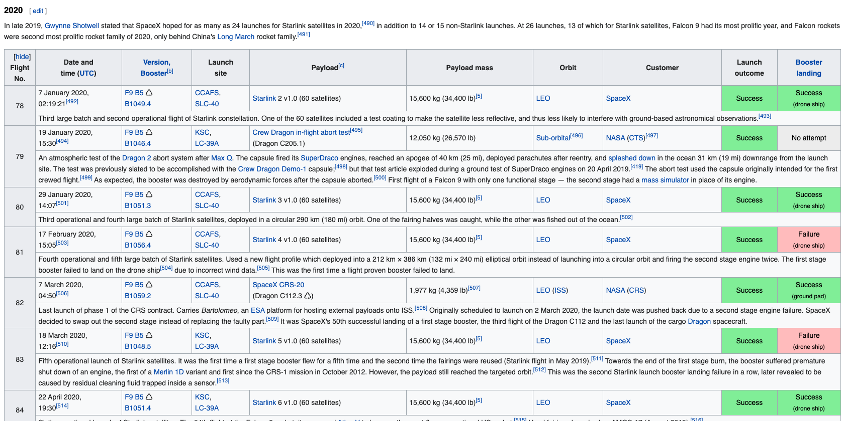
Data Collection
The Falcon 9 first stage data collection was done with a get request to the SpaceX API and by web scraping the Falcon 9 Wikipedia page.

Slide 8







Data Collection – SpaceX API
Request to the SpaceX API
Clean the requested data
GitHub URL to Notebook
1. Request and parse the SpaceX launch data
2. Filter the dataframe
3. Dealing with missing values
4. Export to CSV

Slide 9






Data Collection – Scraping
Extract a Falcon 9 launch records HTML table from Wikipedia
Parse the table and convert it into a Pandas data frame
GitHub URL to Notebook
1. Request the Falcon9 Launch Wiki page
2. Extract all column/variable names
3. Create a data frame
4. Export to CSV

Slide 10
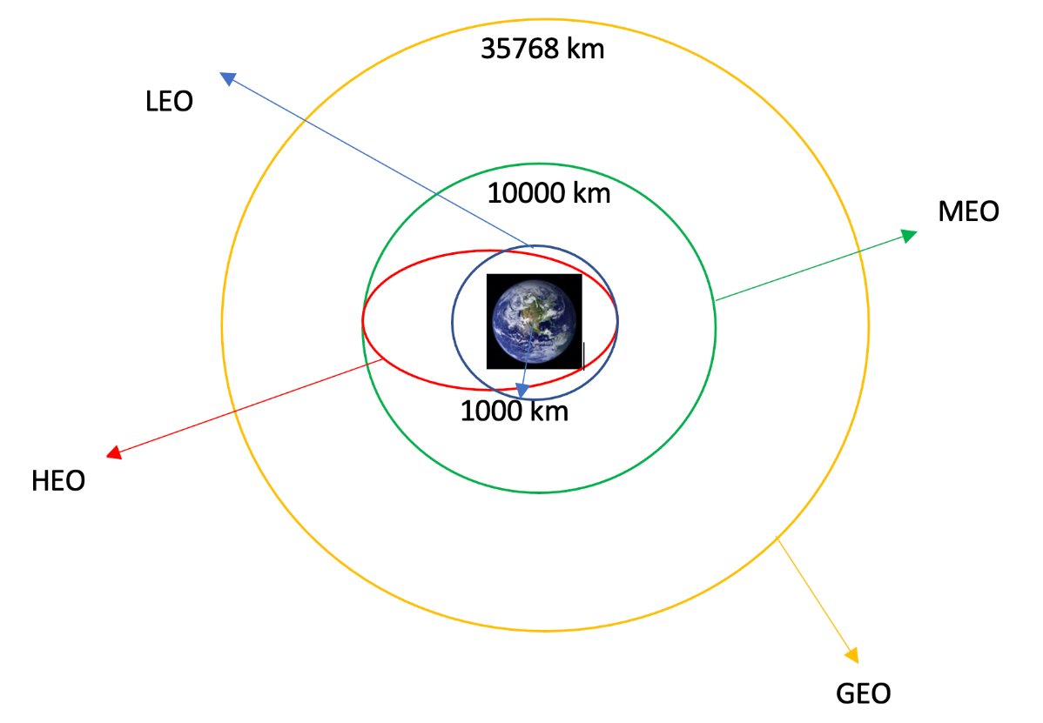
Data Wrangling
Exploratory Data Analysis (EDA)
Calculate the number of launches on each site
Calculate the number and occurrence of each orbit
Calculate the occurrence of mission outcome
Determine Training Labels
Create a landing outcome label
Each launch aims to a dedicated orbit.
GitHub URL to Notebook

Slide 11



EDA with Data Visualization
Scatter Graphs
Flight Number vs Payload Mass
Flight Number vs Launch Site
Payload Mass vs Launch Site
Flight Number vs Orbit
Payload Mass vs Orbit
Bar Chart
Orbit vs Success Rate
Line Chart
Year vs Sucess Rate
GitHub URL to Notebook

Slide 12
EDA with SQL
Display the names of the unique launch sites in the space mission
Display 5 records where launch sites begin with the string 'CCA’
Display the total payload mass carried by boosters launched by NASA (CRS)
Display average payload mass carried by booster version F9 v1.1
List the date when the first succesful landing outcome in ground pad was achieved
List the names of the boosters which have success in drone ship and have payload mass greater than 4000 but less than 6000
List the total number of successful and failure mission outcomes
List the names of the booster_versions which have carried the maximum payload mass
List the records which will display the month names, failure landing_outcomes in drone ship ,booster versions, launch_site for the months in year 2015
Rank the count of successful landing_outcomes between the date 04-06-2010 and 20-03-2017 in descending order
GitHub URL to Notebook

Slide 13
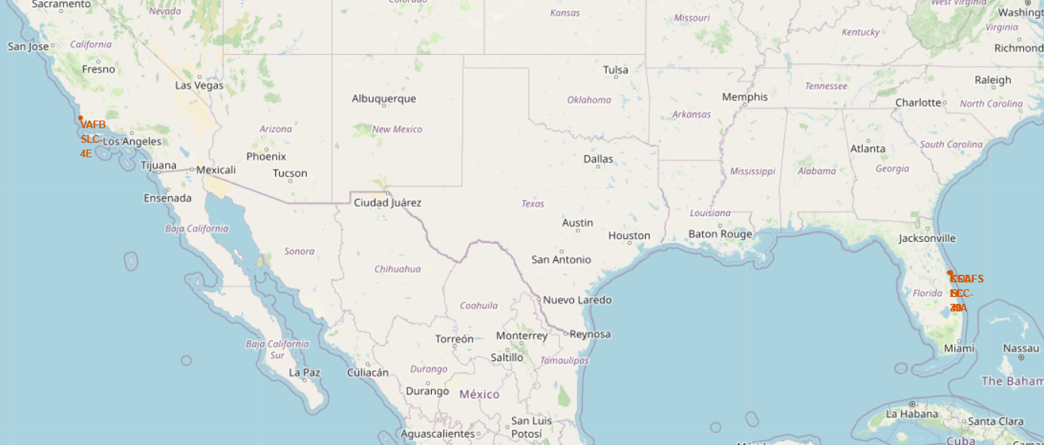
Build an Interactive Map with Folium
Mark all launch sites on a map

Slide 14
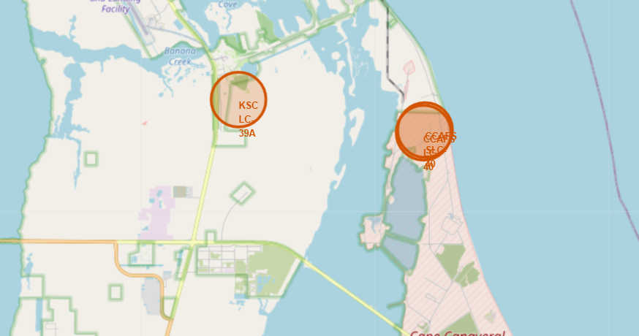
Build an Interactive Map with Folium
Mark all launch sites on a map
We can observe that all launch sites are in proximity to the Equator line and very close proximity to the coast.
GitHub URL to Notebook

Slide 15
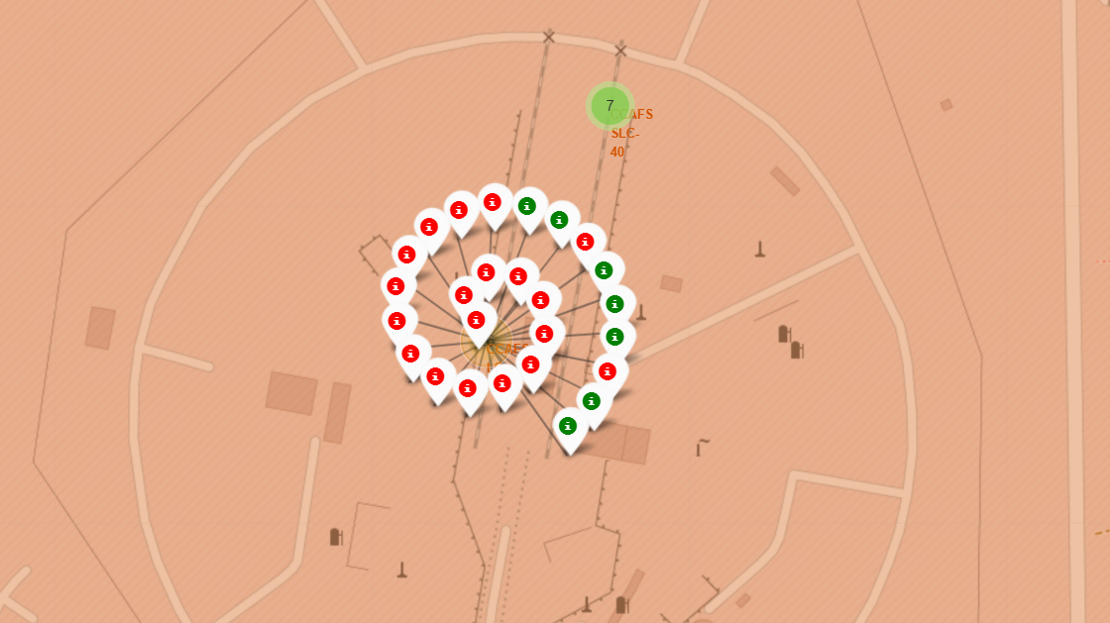
Build an Interactive Map with Folium
Mark the success/failed launches for each site on the map
Shows the success and failed launches for each site in na interactive map.
GitHub URL to Notebook

Slide 16
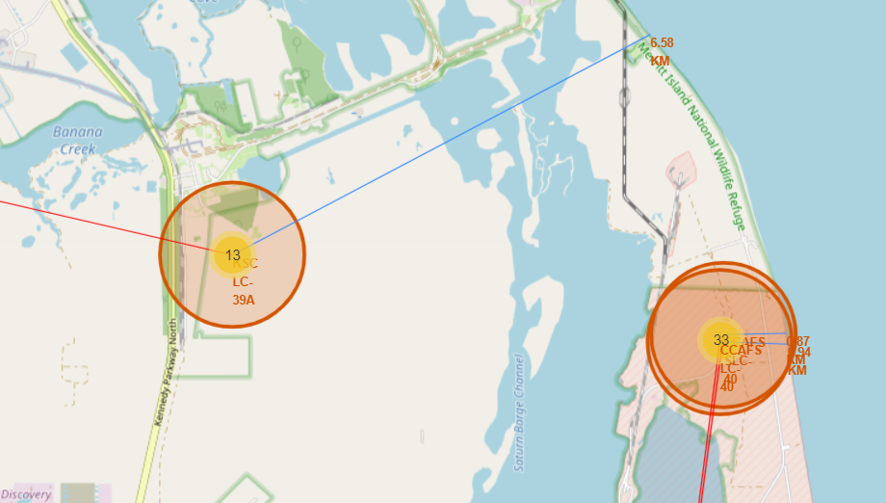
Build an Interactive Map with Folium
Calculate the distances between a launch site to its proximities
Shows the distances between a launch site to its proximities in an interactive map.
GitHub URL to Notebook

Slide 17
Build a Dashboard with Plotly Dash
The dashboard is built with Flask and Dash web framework.
Graphs
Pie Chart showing the total launches by a certain site or all sites.
Scatter Graph showing the relationship with Outcome and Payload Mass
GitHub URL to Notebook

Slide 18
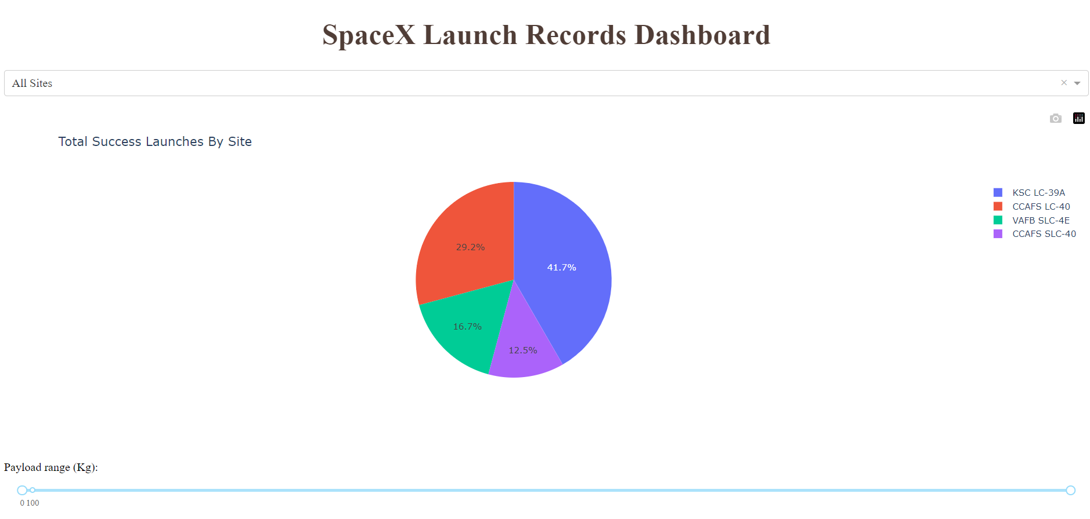
Build a Dashboard with Plotly Dash
GitHub URL to Notebook

Slide 19
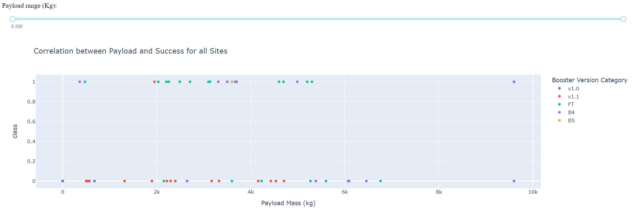
Build a Dashboard with Plotly Dash
GitHub URL to Notebook

Slide 20
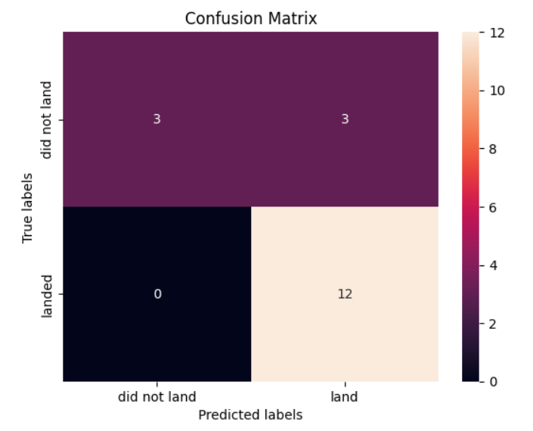
Predictive Analysis (Classification)
Load the data
Standardize the data and fit the model
Split the data into train and test
Create different models:
Logistic Regression
Support Vector Machine (SVM)
Decision Tree Classifier
K Nearest Neighbors
Calculate the accuracy on each model
Build a confusion matrix to visualize the accuracy
Compare the predictions accuracy for each model
GitHub URL to Notebook

Slide 21
Results
Exploratory data analysis results
Interactive analytics demo in screenshots
Predictive analysis results

Slide 22

Section 2

Slide 23
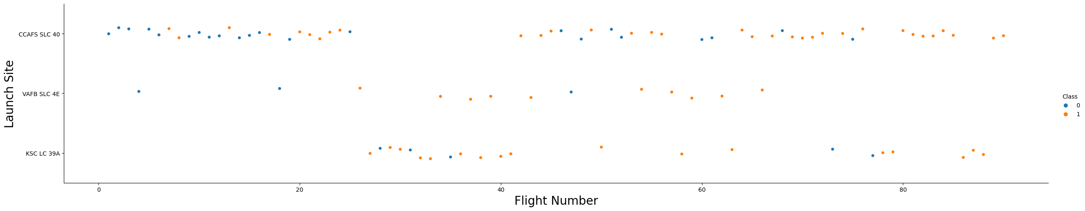
Flight Number vs. Launch Site
The larger the flight amount at a launch site, the greater the success rate at a launch site.

Slide 24
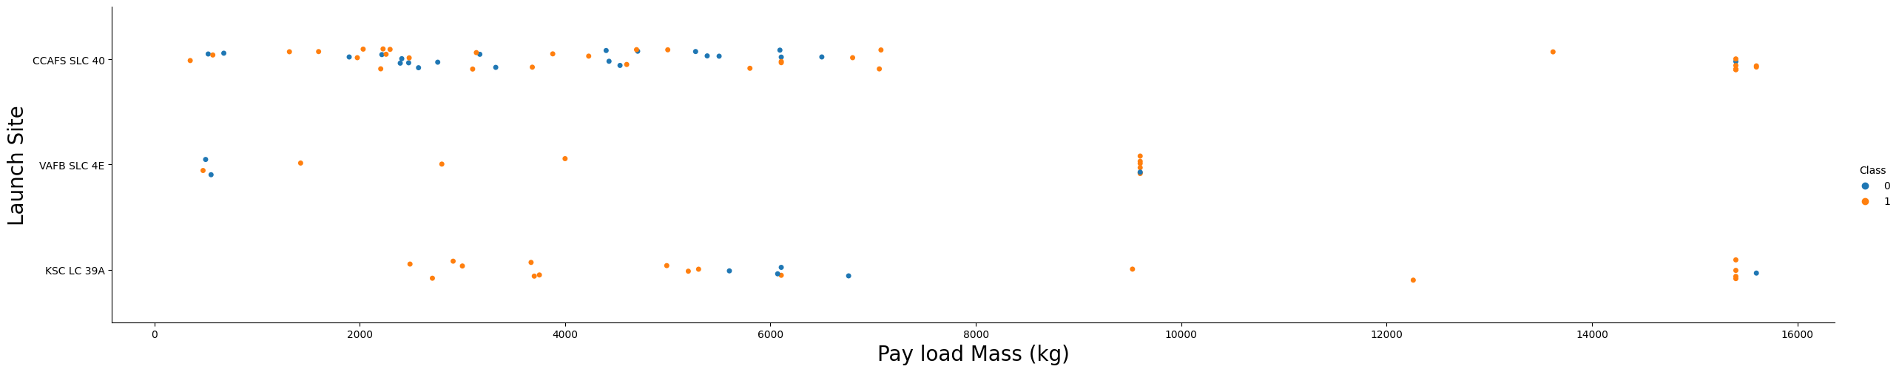
Payload vs. Launch Site
It seems that the greater the payload for Launch Site CCAFS SCL 40, the higher the success rate for the rocket. However, there is not a quite clear pattern for the other Launch Sites.

Slide 25
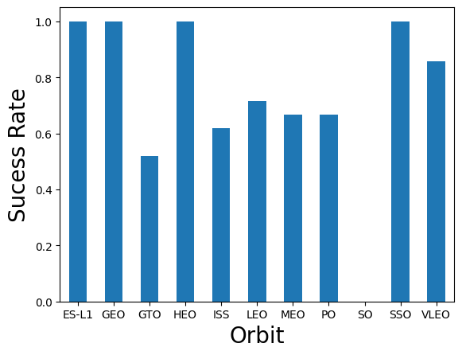
Success Rate vs. Orbit Type
The most success rate are for the orbits:
ES-L1
GEO
HEO
SSO

Slide 26
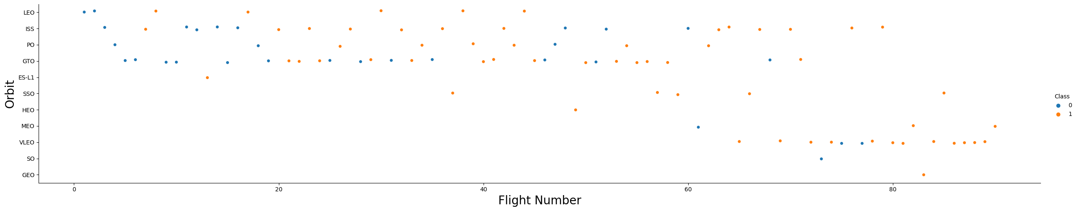
Flight Number vs. Orbit Type
In the LEO orbit, it seems to have a relation between the number of flights and the success. However, the GTO orbit shows no relationship between flight number and success.

Slide 27
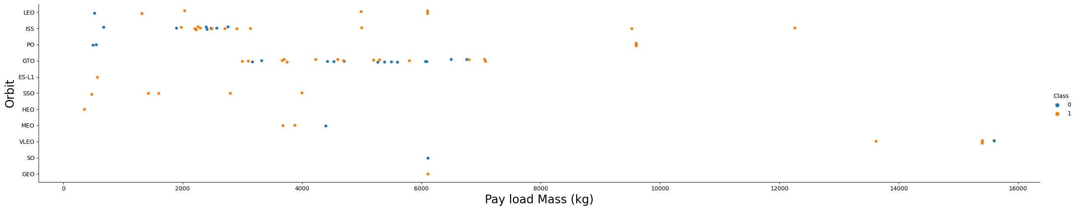
Payload vs. Orbit Type
Heavy payloads seems to have a negative influence on GTO orbits and positive on LEO and ISS orbits.

Slide 28
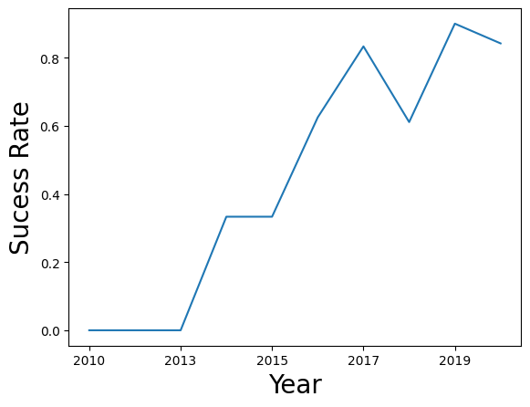
Launch Success Yearly Trend
The success rate kept increasing since 2013 till 2020

Slide 29
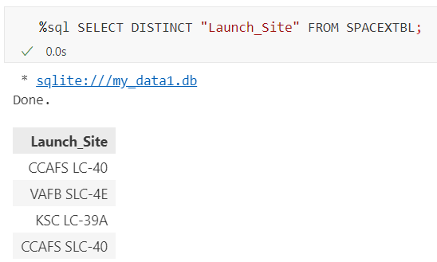
All Launch Site Names
Find the names of the unique launch sites

Slide 30
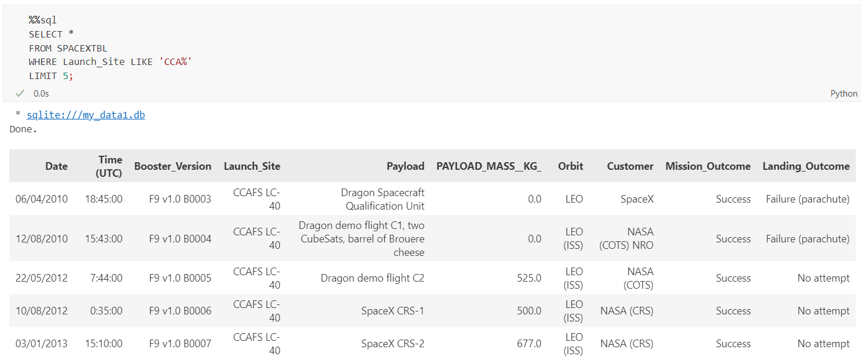
Launch Site Names Begin with 'CCA'
Find 5 records where launch sites begin with `CCA`

Slide 31
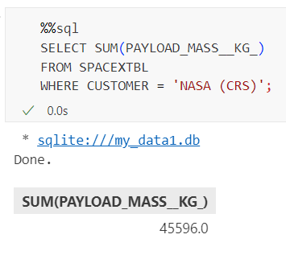
Total Payload Mass
Calculate the total payload carried by boosters from NASA

Slide 32
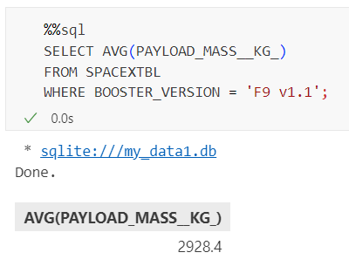
Average Payload Mass by F9 v1.1
Calculate the average payload mass carried by booster version F9 v1.1

Slide 33
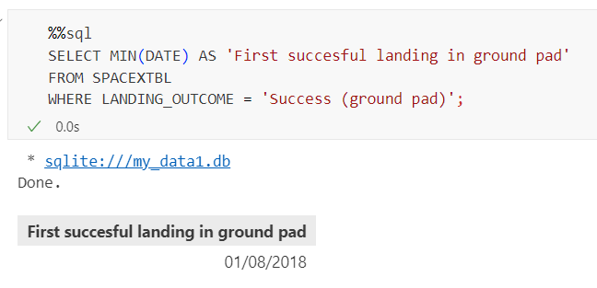
First Successful Ground Landing Date
Find the dates of the first successful landing outcome on ground pad

Slide 34
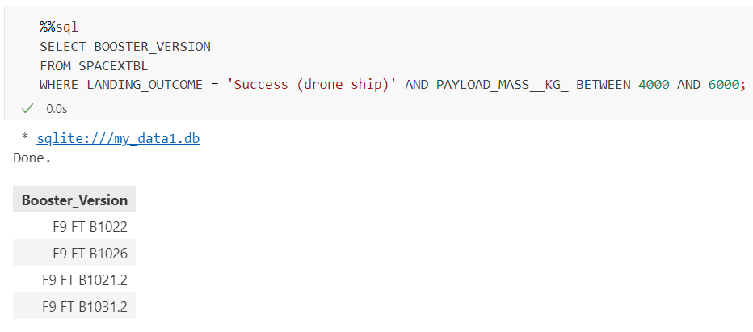
Successful Drone Ship Landing with Payload between 4000 and 6000
List the names of boosters which have successfully landed on drone ship and had payload mass greater than 4000 but less than 6000

Slide 35
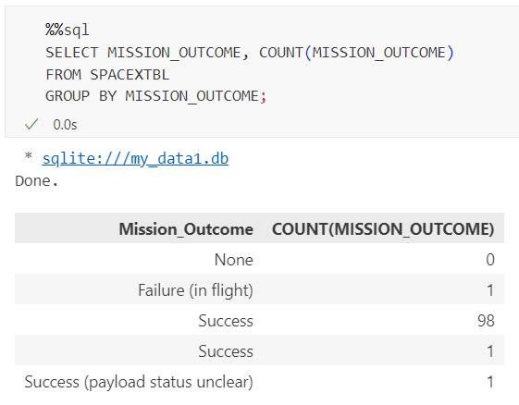
Total Number of Successful and Failure Mission Outcomes
Calculate the total number of successful and failure mission outcomes

Slide 36
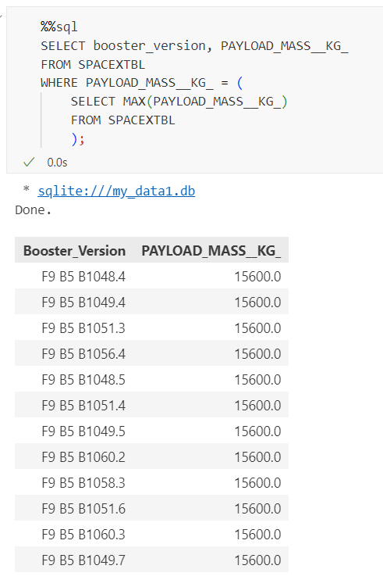
Boosters Carried Maximum Payload
List the names of the booster which have carried the maximum payload mass

Slide 37
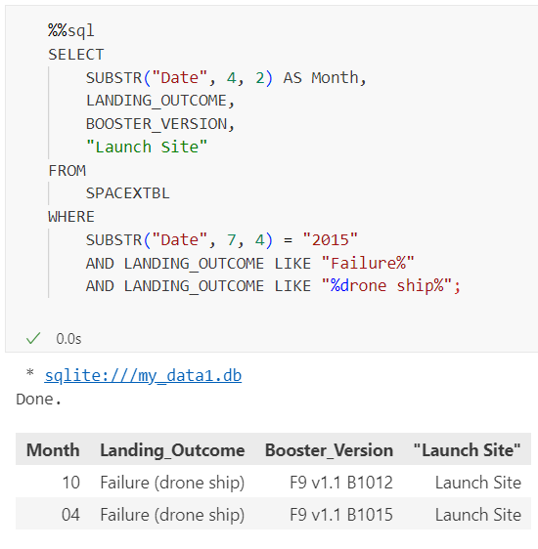
2015 Launch Records
List the failed landing_outcomes in drone ship, their booster versions, and launch site names for in year 2015

Slide 38
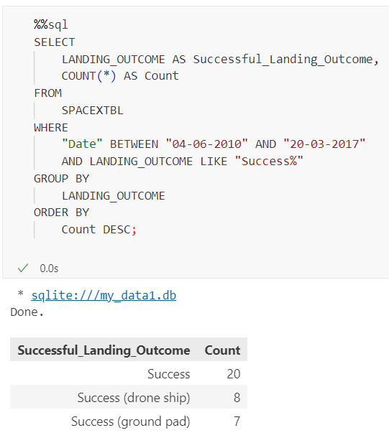
Rank Landing Outcomes Between 2010-06-04 and 2017-03-20
Rank the count of landing outcomes (such as Failure (drone ship) or Success (ground pad)) between the date 2010-06-04 and 2017-03-20, in descending order

Slide 39

Section 3

Slide 40
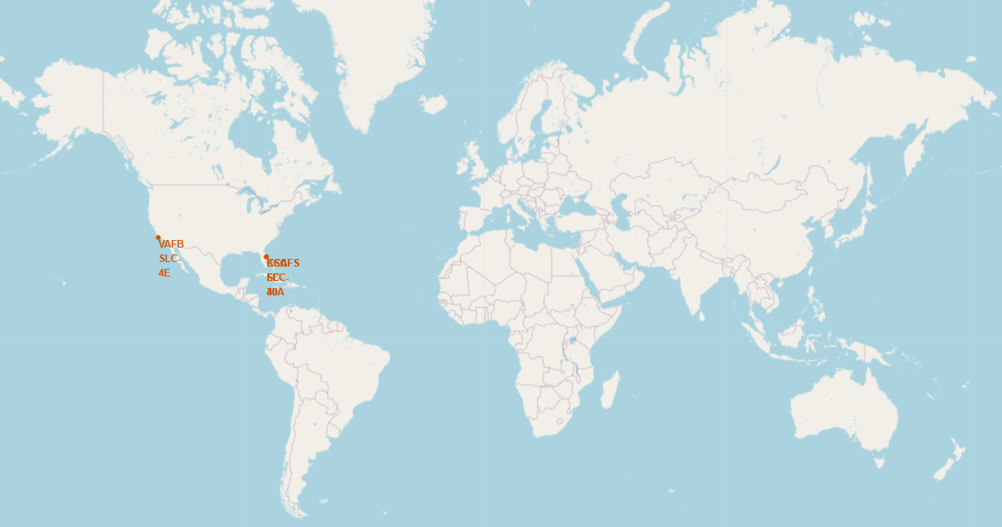
All Launch Sites – Global Markers
As we can se, the SpaceX launch sites are in the United States of America coasts (Florida and California).

Slide 41
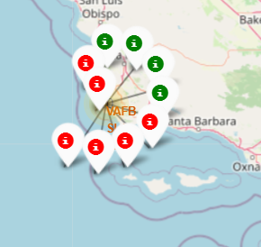
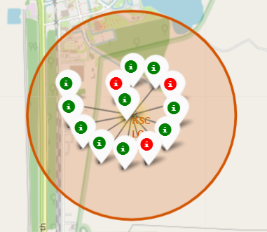
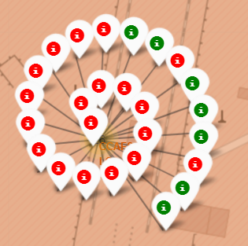
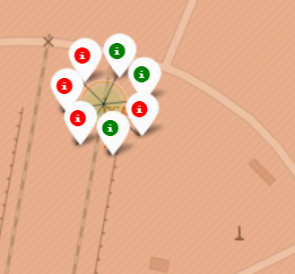
Color Labelled Markers
California Launch Site
VAFB-SLC4E
Florida Launch Site
KSC LC-39A
Florida Launch Site
CCAFS LC-40
Florida Launch Site
CCAFS SLC-40
*Green Markers shows successful launches and Red Markers shows failures.

Slide 42
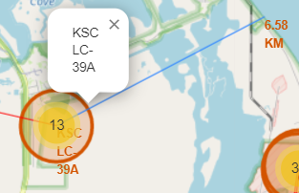
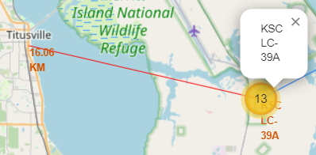
Distance to Landmarks
Distance to coastline
Distance to city
The launch sites are in close proximity to coastline and keep certain distance away from cities, railways and highways.

Slide 43

Section 4

Slide 44
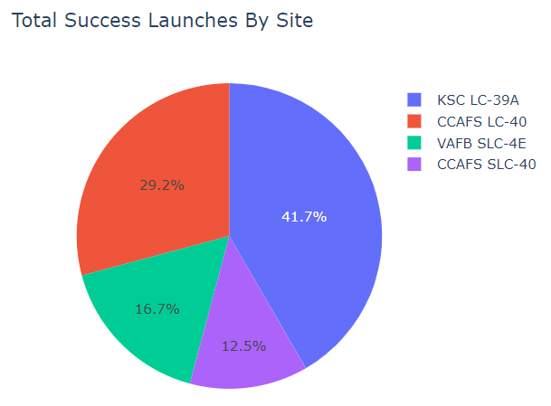
Total Success Launches By Site
KSC LC-39 A has the most successful launches

Slide 45
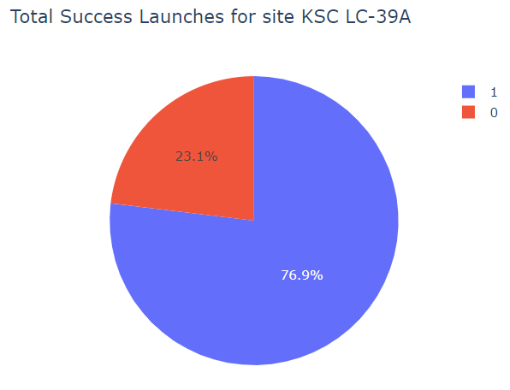
Total Success Launches for KSC LC-39A
KSC LC-39A achieved a 76,6% success rate.

Slide 46
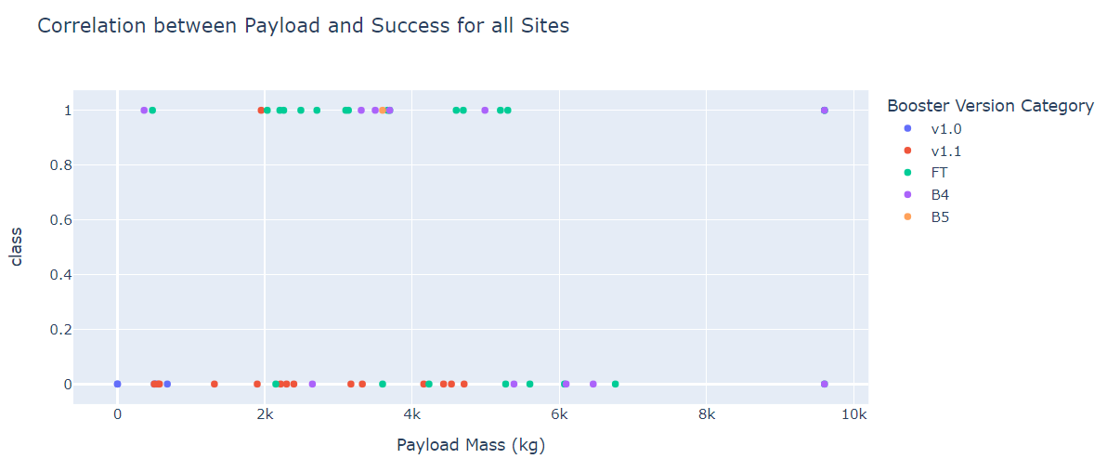
Payload vs Success for Booster Category
We can see that the success rate is higher for low weighted payloads.

Slide 47

Section 5

Slide 48
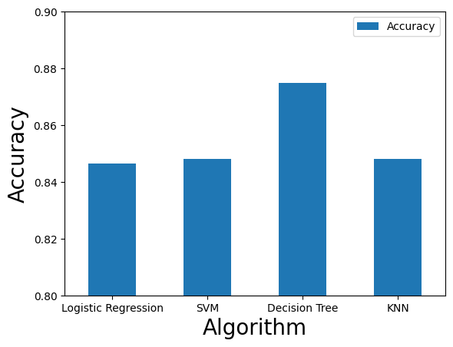
Classification Accuracy
The Decision Tree model has the highest classification accuracy

Slide 49

Confusion Matrix
The Decision Tree model predicted 12 landed and 3 not landed right. But missed 3 not landed.

Slide 50
Conclusions
Correlation between launch site activity and success rate: There is a positive relationship between the number of flights conducted at a launch site and the likelihood of a successful launch. As the flight amount increases at a particular site, the success rate also tends to increase.
Temporal trends in launch success: Starting from 2013 and continuing until 2020, there has been a notable upward trend in launch success rates. Over this period, the probability of a successful launch has been consistently increasing.
Success rates for different orbits: Orbits such as ES-L1, GEO, HEO, SSO, and VLEO demonstrate the highest success rates compared to other orbits. These specific orbits have shown a greater likelihood of achieving a successful mission.
Outstanding performance of KSC LC-39A launch site: Among all launch sites, KSC LC-39A stands out as the site with the highest number of successful launches. It has consistently achieved a remarkable track record in terms of launch success.
Optimal machine learning algorithm: The Decision Tree model has been identified as the most effective machine learning algorithm for this particular task. It outperforms other algorithms in accurately predicting the success or failure of rocket launches.

Slide 51


